Slide 1
Digital Data Transmission

Slide 2
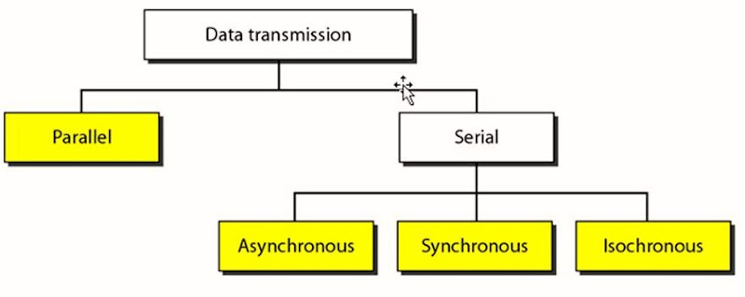

Slide 3
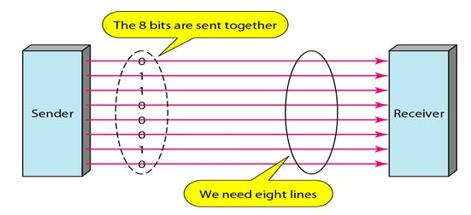
Parallel Transmission
Multiple bit can be sent at one clock tick
To send 8 bits, 8 separate lines are required
Advantages:
High Speed
Disadvantages:
Cost
Limited to shorted distance

Slide 4
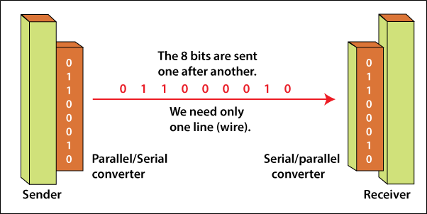
Serial Transmission

Slide 5
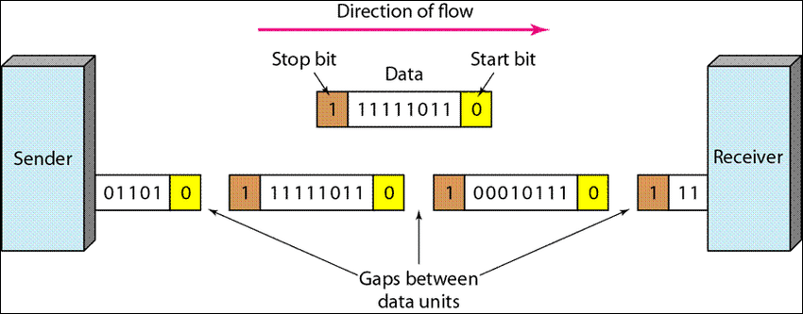
Asynchronous Serial Transmission
Time is not important
Send every byte with start and stop bit
0→ start bit. Alerting receiver that data is coming
1→ stop bit, indicating end of byte
Gap is variable. Variable interval between data units

Slide 6
Applications:
Low speed transmission of narrow band
Slow speed voice channel
Manual operated devices
Low speed communication where gap occur like keyboard

Slide 7
Advantages and Disadvantages
Advantages
Very cheap (less costly)
Effective
Disadvantages
Slow
Additional overhead of start and stop bit

Slide 8
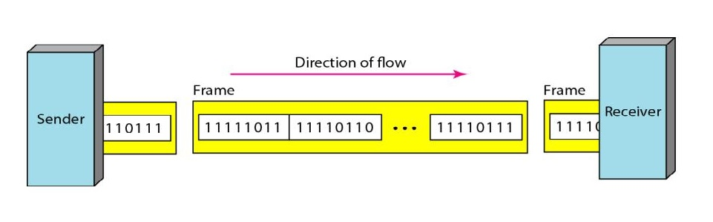
Synchronous Serial Transmission
Time is important
High speed data transmission
Multiple bytes send together
Receiver receive data continuously until detect special ending character
No gaps
Perform error detection using CRC

Slide 9
Advantages:
High speed
No gap
No overhead
Disadvantage:
Real time transmission cannot be possible
Applications:
Fast voice and broadband channel
Computer to computer communication

Slide 10
Isochronous Serial Transmission

Slide 11
Application:
High rate of transmission than asynchronous
Real time audio and video and TV

